Slide 1
Plugfest
Michael McCool
2020 June 23

Slide 2
Outline
Setup
Full week
One hour a day sync meeting
VPN used to simulate a local LAN
https://github.com/w3c/wot-testing/tree/master/events/2020.06.Online
New Accomplishments
Outcomes
Next Steps - Discussion

Slide 3
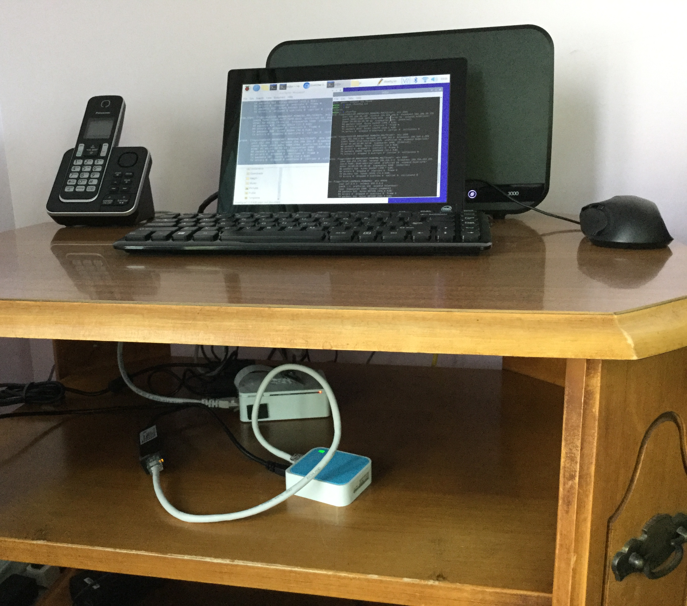
Setup
VPN to simulate local area network behind a NAT
NAT, DHCP server, and firewall run on small (1GB) AWS cloud instance
Bridge so devices downstream do not realize they are sharing a VPN
Bridge computer itself can also host services that appear on the VPN

Slide 4
New Accomplishments
Searchable directory services automatically populated with TDs, supporting discovery via DNS-SD
Autopopulation of Node-RED from directory
Testing via W-ADE tool from TUM
Hypermedia control prototypes

Slide 5
Outcomes
See issues marked with "Plugfest Outcomes" label in wot-testing:
Balance Validation and Experimentation
Need to define appropriate DNS-SD service types
More generally, typed links
Get Validation and Reporting tools ready before the plugfest
Usefulness of the VPN
Xpath features useful for discovery
IDs needed for primary keys
LinkSmart design tried to use id field in TD as a primary key but since these are optional, this tripped on TDs that omitted them. Information and API model of directories needs to use temporary keys.

Slide 6
Next Steps - Discussions
What could have been done better?
What should we do next time?

